Slide 1
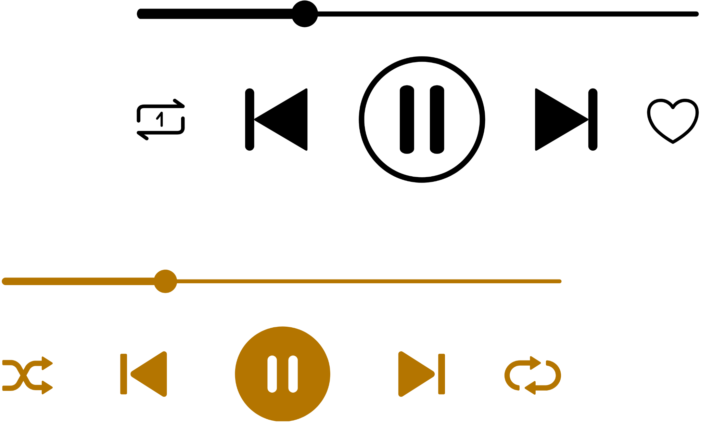
LLMs for Music Understanding
ISMIR 2026 Tutorial: LLMs x Music
CHAPTER 2.
Presented by Zachary Novack

Slide 2

LLMs for Music Understanding
What is “music” (if you’re an LLM)?
What is “understanding” (if you’re an LLM)?
How can we check if LLMs “understand” “music”?

Slide 3
LLMs for Music Understanding
What is “music” (if you’re an LLM)?
Music as audio, image, and text
What is “understanding” (if you’re an LLM)?
Perception vs. reasoning
How can we check if LLMs “understand” “music”?
Evaluating music LLMs

Slide 4
Music Representations in LLMs
Audio Domain?
Symbolic Domain?
How do we translate those features into an LLM?
How do we featurize music?

Slide 5

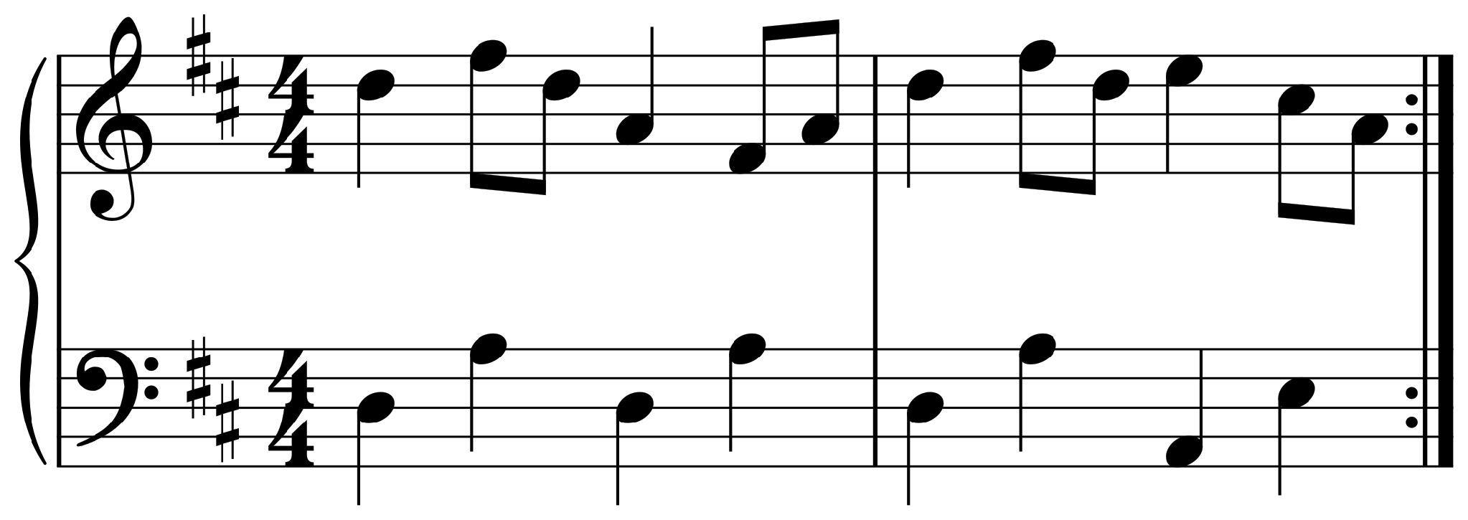
Three ways to hand music to an LLM
INTERFACES
Music as audio
Music as image
Music as text
a waveform or spectrogram
a picture of the score
ABC, **kern, MusicXML, code
K:D
|: d2fd A2FA |
d2fd e2cA :|
Audio encoder + adapter
Vision encoder (any VLM)
Tokenizer (any LLM)

Slide 6
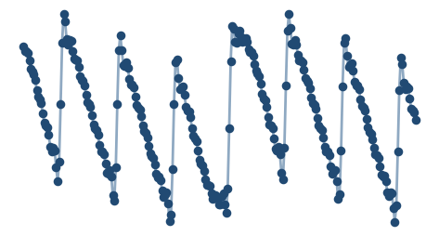
Music as Audio
INTERFACES · AUDIO
Time domain
44,100
samples per second (CD quality)
≈ 16M
numbers in a 3-minute stereo song
Zoom in on 12 ms: each dot is one sample. Stereo audio is two of these lists.
128K–1M
tokens in a frontier LLM context window

Slide 7
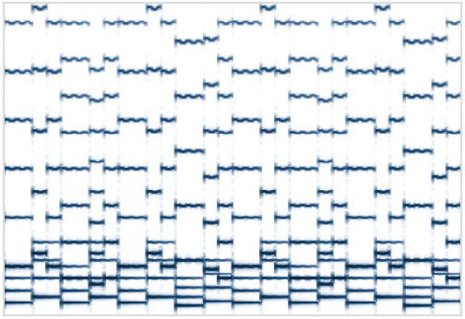

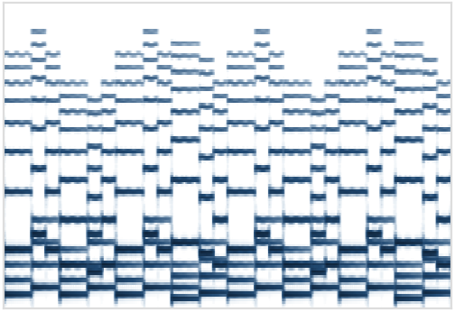
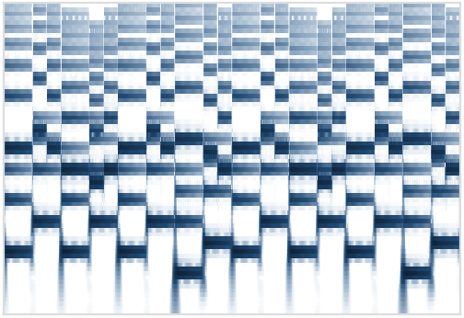
Before the encoder: optional pre-transforms
INTERFACES · AUDIO
STFT magnitude
STFT phase
Mel spectrogram
Constant-Q transform
Energy per frequency bin, frame by frame
Needed to invert the STFT; looks like noise, usually dropped
Frequency warped to match hearing; Whisper's input
Log-spaced bins, one per semitone; music-friendly
No pre-transform: neural codecs (EnCodec, DAC) and Jukebox read the raw waveform with a learned encoder.
Lossless rearrangements: a polyphase split, e.g. Gemma 4 12B's 40 ms frames of 640 samples; or PQMF sub-bands, e.g. RAVE's 16 bands.
Pre-transforms are fixed functions with nothing learned, so each one is a design choice. Défossez et al., EnCodec (2023); Caillon & Esling, RAVE (2021); Gemma 4 tech report (2026).

Slide 8
The dominant recipe: encode, adapt, interleave
INTERFACES · AUDIO
Audio
encoder
Adapter
audio embeddings
waveform or mel
vectors or codes
fits LLM width
The LLM reads one sequence: text tokens with audio embeddings dropped in
Listen
to
<audio>
</audio>
What
key
is
it?
LLM
It's in D major.
Same next-token loss as Chapter 1: only the text after the audio is trained on.
Qwen2-Audio, SALMONN, LLark, MusiLingo, Audio Flamingo 3, Music Flamingo, and Qwen3-Omni all follow this pattern.

Slide 9
Where does the audio encoder come from?
INTERFACES · AUDIO
Reuse a pretrained one
Train one for the LLM
No encoder at all
Whisper Qwen2-Audio, SALMONN
AuT Qwen3-Omni
dMel features Inkling
speech recognition
trained from scratch on 20M hours; replaces Whisper
quantized mel → a light-weight embedding layer
CLAP Audio Flamingo 2 (AF-CLAP)
audio–text contrastive
AF-Whisper Audio Flamingo 3
Raw waveform Gemma 4 12B
MERT MU-LLaMA, MusiLingo
Whisper large-v3, further trained to caption audio
40 ms chunks (640 samples) → projected directly
music self-supervised
Jukebox LLark
music generative model
More borrowed knowledge
More flexibility, more data needed
Qwen3-Omni tech report (2025); Audio Flamingo 2/3 (NVIDIA); Inkling (Thinking Machines, 2026); Gemma 4 tech report (2026); LLark (ICML 2024).

Slide 10
Or encode to discrete codes
INTERFACES · AUDIO
codebook 1
412
87
1503
9
766
waveform
Codec
encoder
New rows in the
LLM's embedding table
residual → 2
31
1208
5
640
77
residual → 3
902
14
355
1290
8
convolutional
each code is a new token
residual vector quantization
Codecs
Codes as LLM tokens
Trade-off
EnCodec: 75 frames per second at 24 kHz.
DAC: 44.1 kHz audio at 8 kbps (about 90× smaller), 86 frames per second.
AnyGPT: EnCodec at 32 kHz, 50 Hz, 4 codebooks of 2,048 codes.
AudioPaLM: w2v-BERT tokens, 25 per second, vocabulary of 1,024.
+ The same tokens serve listening and generating.
− Long: 8 codes × 75 Hz = 600 tokens per second if each code is a token.
Codes shown are illustrative. Défossez et al., EnCodec (TMLR 2023); Kumar et al., DAC (NeurIPS 2023); Zhan et al., AnyGPT (ACL 2024); Rubenstein et al., AudioPaLM (2023).

Slide 11
Adapters: from encoder output to LLM input
INTERFACES · AUDIO
Projection (MLP)
Q-Former (querying transformer)
N outputs → linear → LLM
Feed-forward
× L layers
Cross-attention: queries read the frames
Self-attention: queries talk to each other
keys & values
Every encoder frame becomes one LLM embedding.
q1
q2
q3
q4
Keeps time detail; long songs mean long sequences.
N learned queries
audio frames (any length)
Fixed budget: always N tokens, however long the audio (BLIP-2: 32).
LLaVA, Qwen2-Audio, LLark, Audio Flamingo 3
SALMONN: one query per 0.33 s window, so 30 s of audio → 88 tokens.
Blue: encoder frames. Gold: learned queries and what the LLM receives. Li et al., BLIP-2 (2023); Tang et al., SALMONN (ICLR 2024).

Slide 12
Self-attention or cross-attention?
INTERFACES · AUDIO
Cross-attend from the side
Put audio in the sequence
LLM block (frozen)
LLM block: self-attention over everything
gated cross-attention (new)
LLM block (frozen)
gated cross-attention (new)
audio features
text tokens only
text and audio tokens share one sequence
New layers read the audio; gates start at 0, so training starts from the original LLM.
No new layers, but audio competes for context: a 3-minute song at 12.5 Hz is ≈ 2,250 tokens.
Flamingo, Audio Flamingo 1 and 2 (XATTN-Dense)
Qwen2-Audio, Qwen-Omni, SALMONN, Audio Flamingo 3
Trend: most recent audio LLMs use self-attention. Audio Flamingo moved from cross-attention (AF2) to an MLP adaptor (AF3).

Slide 13
Inside self-attention: where does the audio go?
INTERFACES · AUDIO
Prefix
Qwen2-Audio, SALMONN, LLark
One clip up front, then the question.
Used for: Single-turn audio QA and captioning
Coarse interleaving
Audio Flamingo 3 (multi-turn, multi-audio chat)
Whole clips placed between turns of text.
Used for: Multi-turn chat, comparing clips, few-shot examples
Fine interleaving
CosyVoice 2 (5 text : 15 speech), GLM-4-Voice (13 : 26), Qwen2.5-Omni (2 s chunks)
Short text and audio chunks alternate on a shared timeline.
time
Used for: Streaming speech, time-aligned audio + video
For music: fine interleaving fits time-aligned outputs such as lyrics, chords, or captions per section.
Gold: audio tokens. Beige: text tokens. Du et al., CosyVoice 2 (2024); Zeng et al., GLM-4-Voice (2024); Xu et al., Qwen2.5-Omni (2025).

Slide 14
Music as images
INTERFACES · IMAGE
Written down explicitly
Hard to read
Pitch, rhythm, key, meter, and voices are all on the page.
Small, dense symbols whose meaning depends on position; scans and photos add noise.
Score rendered from the running example with Verovio. Mundada et al., WildScore (EMNLP 2025); MSU-Bench (ACL 2026).

Slide 15
Any VLM can already take a score as input!
INTERFACES · IMAGE
Vision encoder (ViT, SigLIP)
LLM
or just a patch projection
image patches
Encoder-free: Fuyu, Inkling, Gemma 4 12B
No music-specific training needed!
Adept, Fuyu-8B (2023); Inkling uses a 4-layer MLP over 40×40 patches.

Slide 16
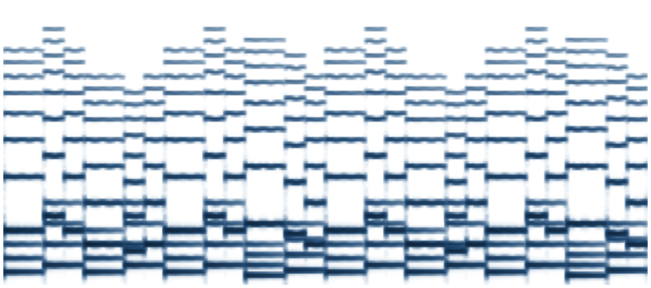
A spectrogram is an image too!
INTERFACES · IMAGE
Off-the-shelf VLM
a text answer
Mel spectrogram of the running example, saved as a PNG
Dixit, Heller & Donahue, VLMs Are Few-Shot Audio Spectrogram Classifiers (2024); Loakman et al., Seeing isn't Hearing (2025).

Slide 17
Music as text: symbolic formats
INTERFACES · TEXT
ABC
**kern (Humdrum)
MusicXML
K:D
V:1
|: d2fd A2FA | d2fd e2cA :|
V:2 clef=bass
|: D,2A,2 D,2A,2 |
D,2A,2 A,,2E,2 :|
*staff2 *staff1
*clefF4 *clefG2
*k[f#c#] *k[f#c#]
*M4/4 *M4/4
=1- =1-
4D 4dd
4A 8ff#L
. 8ddJ
4D 4a
4A 8f#L
. 8aJ
<note>
<pitch>
<step>D</step>
<octave>5</octave>
</pitch>
<duration>10080</duration>
<type>quarter</type>
102 characters
194 characters
7,539 characters
Compact, widely used for LLM training (ChatMusician, NotaGen)
One column per voice, one row per time slice; used by CSyMR and SymSkill
Verbose but universal; what notation software exports
Also: MEI, LilyPond, MIDI as text (MIDI-LLM), Roman numerals (RNGen).

Slide 18
Music as code
INTERFACES · TEXT
Strudel (live coding)
Code is music that runs
stack(
note("d5 [f#5 d5] a4 [f#4 a4]
d5 [f#5 d5] e5 [c#5 a4]"),
note("d3 a3 d3 a3 d3 a3 a2 e3")
).cpm(15)
Loops, patterns, and transformations instead of fixed notes. LLMs are already good coders.
Decomposer (Kim et al., 2026)
Turns MIDI into a readable Strudel program (SFT, then RL for faithful, readable code).
music21 (analysis)
s = converter.parse("reel.krn")
s.analyze("key") # D major
Tools and MCP servers
DAWs and notation software exposed as functions (Chapter 1).
Strudel snippet plays the running example (two bars per cycle). Kim, Gandhi, Chung, Neubig & Donahue, Decomposer (arXiv 2607.01849).

Slide 19
Music as procedures: skills
INTERFACES · TEXT
Prompt only
CSyMR accuracy
Question + **kern → LLM
No procedure: the model guesses from token patterns
Qwen3.5-4B
42.9% → 48.4%
Tool-augmented
LLM calls get_chords() → “V–I”
best no-skill baseline → with skills
Tool gives facts, but the model skips the soprano check
Skill-augmented
Qwen3.5-9B
Retrieve “cadence type” skill → follow its 7 steps
35.7% → 50.0%
The protocol forces the critical step, no tools needed
best no-skill baseline → with skills
Skills are text: procedures distilled from a music-theory textbook (Open Music Theory) into a graph, then retrieved into the prompt at test time.
Wu et al., SymSkill: Skill Graph for Symbolic Music Understanding (ISMIR 2026). Wang et al., CSyMR (SIGIR 2026).

Slide 20
Text plugs straight into any LLM
INTERFACES · TEXT
No adapter: the tokenizer is the interface. ABC or **kern goes in exactly like any other text.
Prompt a general LLM
Fine-tune a music LLM
Give it tools
Frontier models already read and write ABC, kern, and MusicXML from pretraining.
ChatMusician and NotaGen train on ABC; MIDI-LLM adds MIDI tokens to Llama's vocabulary.
music21 operators (CSyMR: +5.6 points over ReAct without music tools); MCP servers, e.g. for Ableton Live.
No training
More training
More plumbing
Yuan et al., ChatMusician (ACL Findings 2024); Wang et al., NotaGen (IJCAI 2025); Wu et al., MIDI-LLM (NeurIPS 2025 AI for Music workshop); Wang et al., CSyMR (SIGIR 2026); MCP: Chapter 1.

Slide 21
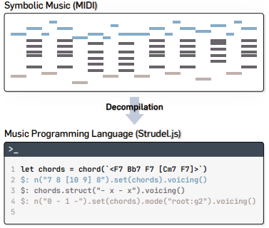
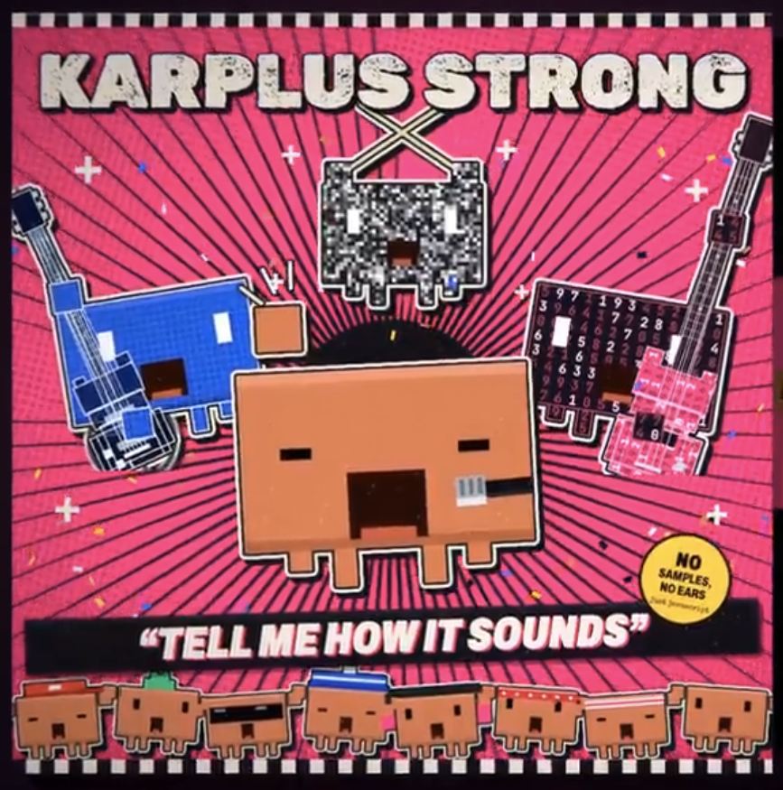
Code-native music is getting good
INTERFACES · TEXT
JS
{}
♪
“Tell Me How It Sounds”
Decomposer
Ableton MCP
A Claude Opus 5.5 music video - everything by claude in JS
MIDI in, Strudel program out!
An LLM drives a DAW through MCP: create tracks, write clips, set devices, all as tool calls.
Community MCP server
Kim et al., arXiv 2607.01849

Slide 22
Recap: what the model sees decides the interface
INTERFACES
 | Audio | Image | Text
The model sees | Samples, codes, or spectrogram frames | Pixels, as patches | Characters, as tokens
Interface | Audio encoder + adapter, or encoder-free | Any VLM's vision path | The tokenizer
Audio-specific training? | Yes | No | No
Strong at | Timbre, performance, production | Engraved notation | Structure, theory, editing
Blind to | Nothing in principle; limited by context and encoder | Anything not on the page | Anything not written down
Representations combine: a model can get the audio and the score together, or call a transcription tool to turn one into the other.

Slide 23
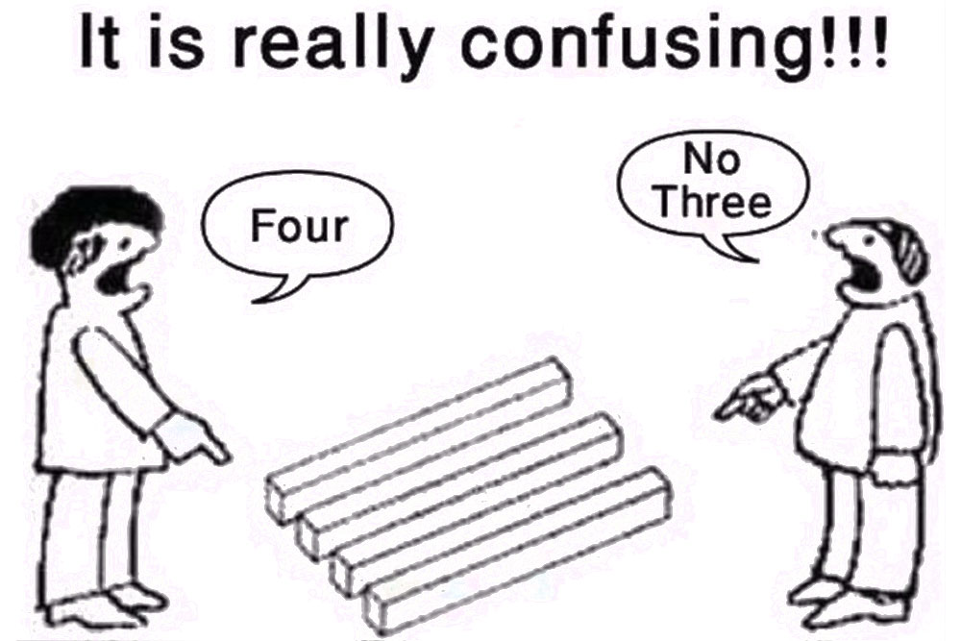
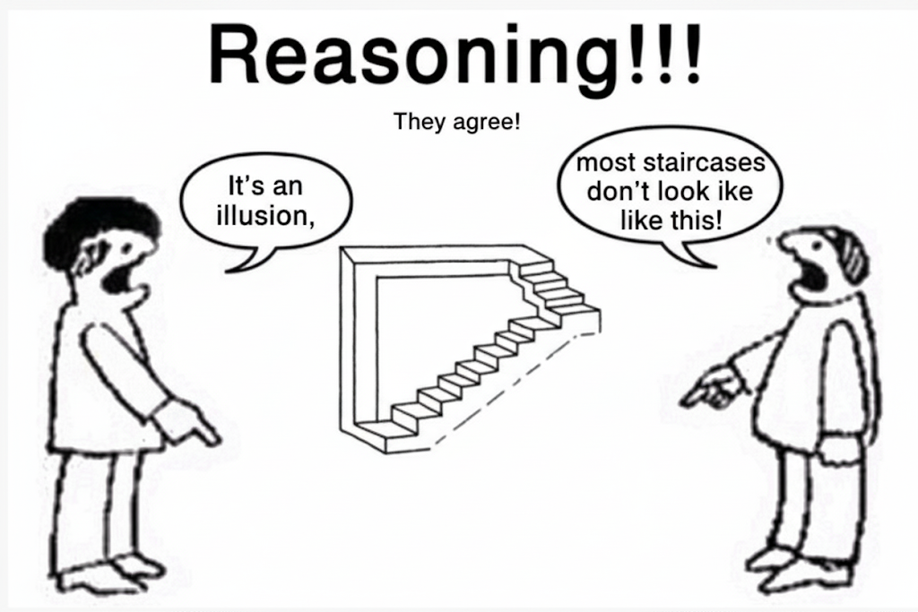
Multimodal (music) understanding requires both:
Perception
Reasoning

Slide 24
Perception vs. reasoning
UNDERSTANDING
Perception
Reasoning
Music
(audio, image, or text)
Answer
Extract what's there: notes, onsets, instruments, symbols on the page
Combine that evidence with knowledge to answer the question
Reasoning can happen in two places
Implicitly
Explicitly
Inside a single forward pass: the model answers directly.
In text the model writes first: chain-of-thought, reasoning traces, tool calls (Chapter 1).
A wrong answer can come from either stage, and the two need different fixes.

Slide 25
Worked example: “What's the melody here?”
UNDERSTANDING
♪ example.wav
1. Perception: which notes sound, when?
2. Reasoning: which notes are the tune?
beat 1
D3 D5
Two streams: a low one moving in quarter notes (D3 A3 D3 A3) and a high one moving in eighths.
The melody is the higher, busier line.
beat 2
A3 F#5 D5
beat 3
D3 A4
beat 4
A3 F#4 A4
D5 F#5 D5 A4 F#4 A4 | D5 F#5 D5 E5 C#5 A4
Perception error: Miss the F#5 and the melody is wrong before reasoning starts.
Reasoning error: Hear every note correctly, then report the bass line.
Notes from the running example, bar 1.

Slide 26
The representation moves the work
UNDERSTANDING
Same question (“What's the melody?”), three inputs, different split between perception and reasoning:
Audio
Perception
Reasoning
hear every note in a mix
Score image
Perception
Reasoning
read symbols off the page
ABC text
Reasoning
notes are already given
Carone et al. (2025): on syncopation, transposition, and chord tasks, models were near ceiling given MIDI but dropped sharply given audio. Chain-of-thought barely helped on audio.
Bar widths are illustrative, not measured.

Slide 27
Disentangle by masking the music
UNDERSTANDING
Fixed question: “Which instrument initiates the piece?” A) Synthesizer B) Rueful tune C) Acoustic guitar D) Vocals
Real music
Gaussian noise
No music at all
the normal test
same length, no musical content
a text-only model guesses
Compare accuracy across the three
Accuracy holds without the music
Accuracy collapses without the music
The model answers from priors: the benchmark measures text knowledge, not listening.
The model is using perception to reach the answer.
Example question from MuChoMusic (Weck et al., ISMIR 2024).

Slide 28
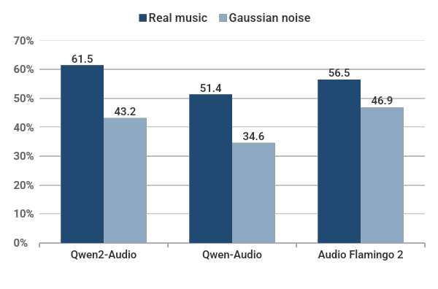
Masking shows how much models actually listen
UNDERSTANDING
chance (25%)
MuChoMusic accuracy
With noise instead of music, every model still scores well above chance.
MMAU-Pro, same test
model
real → noise
Audio Flamingo 3
51.7 → 47.2
Qwen2.5-Omni-7B
52.2 → 30.6
Phi4-MM
38.7 → 34.9
Zang et al., Are You Really Listening? (ISMIR 2025); Kumar et al., MMAU-Pro (random guessing: 23.4%).

Slide 29
Four ways to grade a music LLM
EVALUATION
1
2
3
4
Captioning
Multiple-choice QA
Open-ended QA
Tools & downstream
Describe the clip; compare to reference captions.
Pick A–D; score accuracy. Easy to grade, so it dominates.
Free-form answers, graded by a judge or mapped to labels.
Did the system finish a real task?
Metric: BLEU, BERTScore, LLM judge
Metric: Accuracy
Metric: LLM judge, label F1
Metric: Task success
MusicCaps
MuChoMusic, MMAU, WildScore
MSU-Bench
MusiCRS → Chapter 3
Moving right: closer to what users want, harder to score automatically.

Slide 30
The benchmark landscape
EVALUATION
Audio
Score image
Symbolic text
MuChoMusic
MMAU
WildScore
MusiXQA
MusicTheoryBench
Zhou et al. 2024
MMAR
MMAU-Pro
MSU-Bench
CSyMR
SSMR-Bench
CMI-Bench
RUL-MuChoMusic
MuSP-Bench
MUSE
BASS
HumMusQA
MusiCRS
Across representations: MusICA-MetaBench generates the same questions from MusicXML for audio, score, and text
Audio dominates. Score and symbolic benchmarks are newer, smaller, and mostly from the last year.
Not exhaustive. Venues: ISMIR 2024–26, EMNLP 2025, ACL 2026, SIGIR 2026, ICASSP 2026, NLP4MusA 2026, arXiv.

Slide 31
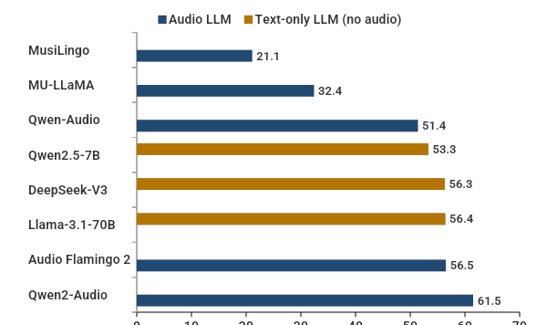
Does the question need the music?
EVALUATION
MuChoMusic accuracy
chance (25%)
Text-only LLMs that never hear the audio match or beat most audio models.
How? Eliminate odd options (“rueful tune” is not an instrument), then guess from world knowledge.
Zang, O'Brien, Berg-Kirkpatrick, McAuley & Novack, Are You Really Listening? (ISMIR 2025). Text-only models told to guess and reason step by step.

Slide 32
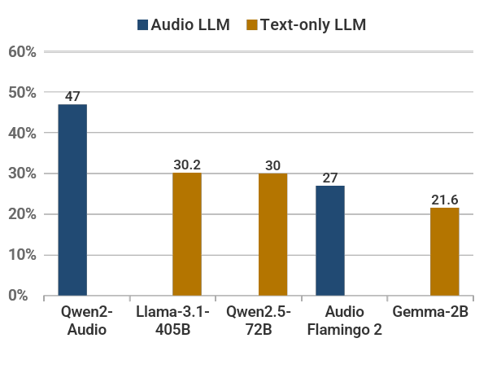
Fixing the distractors: the Perceptual Index
EVALUATION
A good item: p(correct | question, music) ≫ p(correct | question)
PI = p_text(distractors | q) / p_text(all options | q)
1
An LLM writes plausible distractors
2
A small text-only LM scores them
3
Keep the set with the highest PI
RUL-MuChoMusic: text-only falls to chance (dashed line, 25%); listening now pays.
Zang et al. (ISMIR 2025, Best Paper). RUL-MuChoMusic is now reported in the Qwen-Omni and Music Flamingo releases.

Slide 33
Can we trust the grader?
EVALUATION
Text metrics don't notice the music
LLM judges are partial judges
Swap the audio for a random clip and similarity scores on music QA answers barely move.
GPT asked to spot errors in MIR annotations: 65% (beats), 65% (chords), 60% (key).
Fix: map answers to labels (instrument, key, genre…) and score precision, recall, F1.
Better with more music-concept context in the prompt, but far from reliable.
Lin, Freeman & Thickstun, ISMIR 2026
Fang, Wang, Xia & Fujinaga, 2025
Rule of thumb: if the score doesn't change when the music changes, it isn't measuring music.
Judge accuracies are for detecting annotation errors in beat tracking, chord extraction, and key estimation.

Slide 34
Contamination, shortcuts, and who writes the labels
EVALUATION
Contamination
Shortcuts
LLMs train on internet-scale data. Questions mined from Reddit, YouTube, or popular datasets may already be in pretraining.
Models can score well on the wrong cue. Genre Bias or Aesthetic Perception? (ISMIR 2026) asks this of music evaluators.
Who labels?
How many items?
LLM-written questions and labels are now common. Two ISMIR 2026 papers compare human and LLM annotation (Baroque opera affect) and AI-first score labeling.
MusICA-MetaBench: about 300 questions detect a 6-point accuracy gap between two models.
ISMIR 2026: Recovering Affective Signals in Baroque Opera; When AI Annotates First; Genre Bias or Aesthetic Perception?

Slide 35
A checklist for your next music benchmark
EVALUATION
✓
Report a text-only baseline
✓
Validate the judge
If it's near the multimodal score, the benchmark isn't testing the modality.
Against human ratings, on your task.
✓
Run a masked-music control
✓
Assume the internet has seen it
Noise, silence, or a mismatched clip.
Prefer fresh or held-out sources.
✓
Measure distractor quality
✓
Size it for the gap you care about
For example, with the Perceptual Index.
A few hundred items for single-digit differences.
✓
Check the metric moves with the music
What to benchmark matters. How to benchmark matters at least as much.
Swap the input; the score should drop.
Several checks are cheap to add to an existing benchmark after the fact.

Slide 36
Benchmarks are aging faster than ever
LOOKING AHEAD
Each generation needs a harder test
Contamination
General LLMs
Music
LLMs pretrain on the internet. A public benchmark, or the forum threads it was mined from, eventually ends up in training data.
Master-level
What a master musician would catch
open problem
?
Graduate / “PhD-level”
Expert, in-the-wild questions
HumMusQA, WildScore, CSyMR
up to 8%
GPQA, Humanity's Last Exam
accuracy drop for some models on GSM1k, a fresh copy of GSM8K. Models that can reproduce GSM8K items show bigger gaps.
College
Textbook theory
MusicTheoryBench
MMLU
Grade school
Hear the instrument
MuChoMusic
GSM8K
Zhang et al., GSM1k (2024); Rein et al., GPQA (2023); Phan et al., Humanity's Last Exam (2025).

Slide 37
Good evaluation is becoming a moat
LOOKING AHEAD
As models converge on public benchmarks, the ability to tell them apart becomes valuable, and so does owning a hard, clean test set.
Private test sets
Who has access?
Conflicts of interest
Held-out leaderboards (e.g., Scale's SEAL) avoid contamination, but only their owners can inspect them.
FrontierMath was funded by OpenAI, which has its problems and solutions, except a 50-question holdout.
Curators who also sell training data are grading their own customers.
For music: expert music annotation is scarce and expensive, so whoever holds the good evals steers the field. ISMIR already has a public alternative: MIREX, community-run held-out evaluation since 2005.
Epoch AI on OpenAI and FrontierMath (2025); Bansal & Maini, Risks of LLM Evaluation by Private Data Curators (2025).

Slide 38
What's next: benchmarks with real musical depth
LOOKING AHEAD
1
Deeper analysis
2
Time-grounded answers
3
Full songs and stems
Harmony, voice leading, and form over whole pieces, checked against symbolic ground truth.
Not just what, but where: timestamps, bar numbers, sections.
Long-form, multi-track audio, plus production and mix decisions.
4
More traditions
5
Living benchmarks
6
Master-level judges
Maqam, raga, gugak, and beyond, with experts from those traditions.
Regenerated from fresh music (e.g., MusICA-MetaBench) with a held-out core.
Working musicians write and validate questions; report how often experts agree.
Goal: benchmarks that stay ahead of the models, and stay in the community's hands.

Slide 39
So this is cool and all…
LIMITATIONS
…but who actually wants a model that just aces multiple choice tests?
Benchmarks tell us whether a model can perceive and reason about music. They don't tell us whether it helps anyone listen, create, or learn.
Listeners
Composers
Educators
Seungheon Doh
Yewon Kim
Huan Zhang
Next: Chapter 3, LLMs for musical applications.

